Slide 1
British Airways
Customer ratings analysis and insights
2023-12-25

Slide 2
Rating study
Average overall Rating: 4.84/5.00
Customers from 72 countries travel and given the reviews
Total 3714 reviews are collected
What customers are happy and unsatisfied about for different ratings class:
7-10 ratings wrote about comfortable seats, good inflight entertainment, descent food quality.
4-6 ratings faced problem with small entertainment screen, long passport check queue, bad business class experience.
1-3 ratings wrote dissatisfaction on congested middle seat and small screen while they liked the seats and the food.

Slide 3
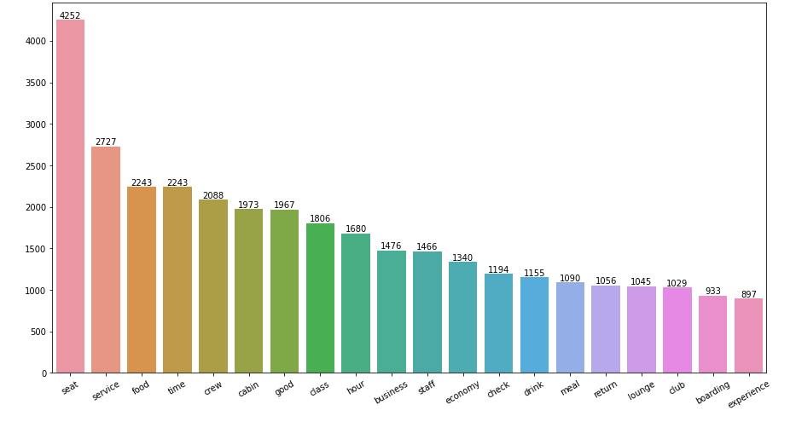
In review customer mostly talking about Seat, service and Food
Focus on – Economy class service, seats, enhance inflight entertainment experience and importantly Delays. Enhance the experience of business class, it seems customers want value for money. Improve Customer service on refund requests and process.

Slide 4
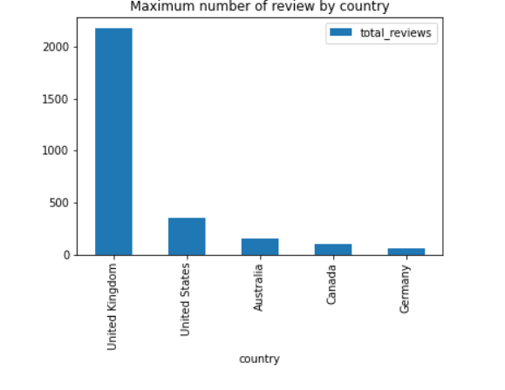
Reviews
Maximum number of reviews are given by United Kingdom people

Slide 5
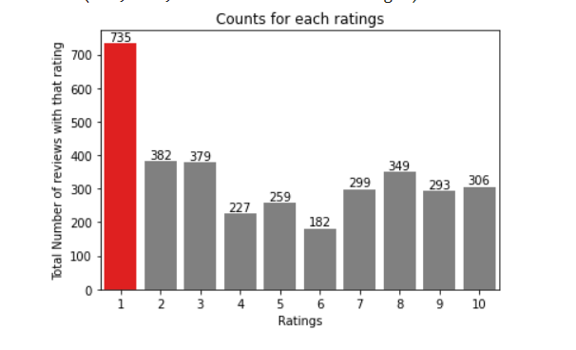
Rating
Comparative to all ratings 1 rating is given by most of the people

